Slide 1
Overnight Pre-caching on Mobile Devices
By: Troy Johnson

Slide 2
Cisco’s mobile growth predictions
The number of mobile-connected devices will exceed the world’s population by 2014. [1]
Not only is data usage increasing dramatically, number of devices per person is also increasing.
The average smartphone will generate 2.7 GB of traffic per month by 2018.
The current average is 529 MB per month.
Total mobile traffic data in 2013 nearly 18 times larger than the entire internet traffic in 2000.

Slide 3
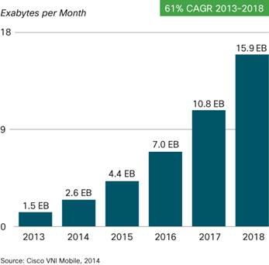
Predicted Mobile Data Growth
Global mobile data traffic will increase nearly 11-fold between 2013 and 2018.

Slide 4
Caching
Mobile caching is currently a popular area for mobile computing research.
Caching limits amount of data that has to be transferred to requesting clients.
Mobile device caches hold on to recently accessed data from websites (such as images) until they expire.
Saves data
Saves power
Webpages load quicker

Slide 5
Overnight Pre-caching
Users typically visit many of the same websites each day
All the information from these websites could be cached ahead of time
Cached sites will be the sites the user visited the previous day
Night time is typically the optimal time to do the caching
Wi-Fi Connection available
Data friendly
Mobile device plugged in
Power friendly
Develop simulation to determine savings that can be achieved by caching websites overnight.

Slide 6
Related Research
Schemes are being developed to predict user movement patterns based off previous days patterns [2].
Movement patterns combined with data about network connection information at each location (speed,type,etc..)
Caching and pre-fetching can be performed when there is a strong network connection.
In [3] the authors develop algorithms for cache replacement and passive pre-fetching of data objects.
GreedyDual Least Utility Model caching mechanism
Considers user requests patterns, mobility hand off, etc..
Simulations show possibility of more than 10% energy savings.

Slide 7
HTTP Archive
Used to gather data for my simulation
Repository of web performance information
Top 1,000,000 desktop sites based on Alexa index
4776 mobile sites
Data retrieved from webpages bi-monthly
Utilizes WebPageTest.org to collect data
Settings set for an iPhone4 with iOS 5
Information only retrieved from landing pages
Page level information (total requests, bytes total,etc..)
Response level information (type of response, response length, etc..)

Slide 8
HTTP Archive (cont.)
October 15, 2013 data set used for my set up
Relevant data:
Response sizes
Expiration ages
Page ids
Page ranks
Once downloaded, data needs to be:
Cleaned
sorted based on page rank (most popular first).
Webpage information put into spreadsheet
Each row contains information about webpage

Slide 9
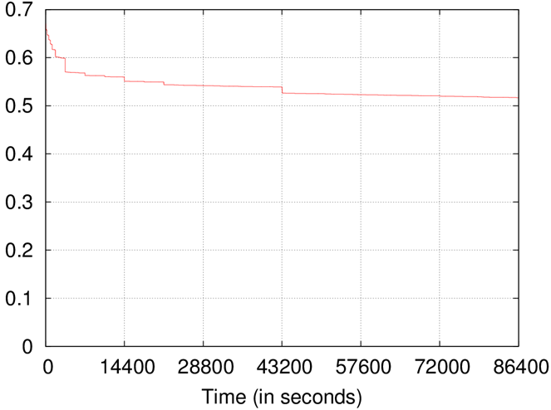
Overall Cache Lifetime Behavior
Bytes remaining in cache over 24 hour period
Proportion of Bytes remaining in cache

Slide 10
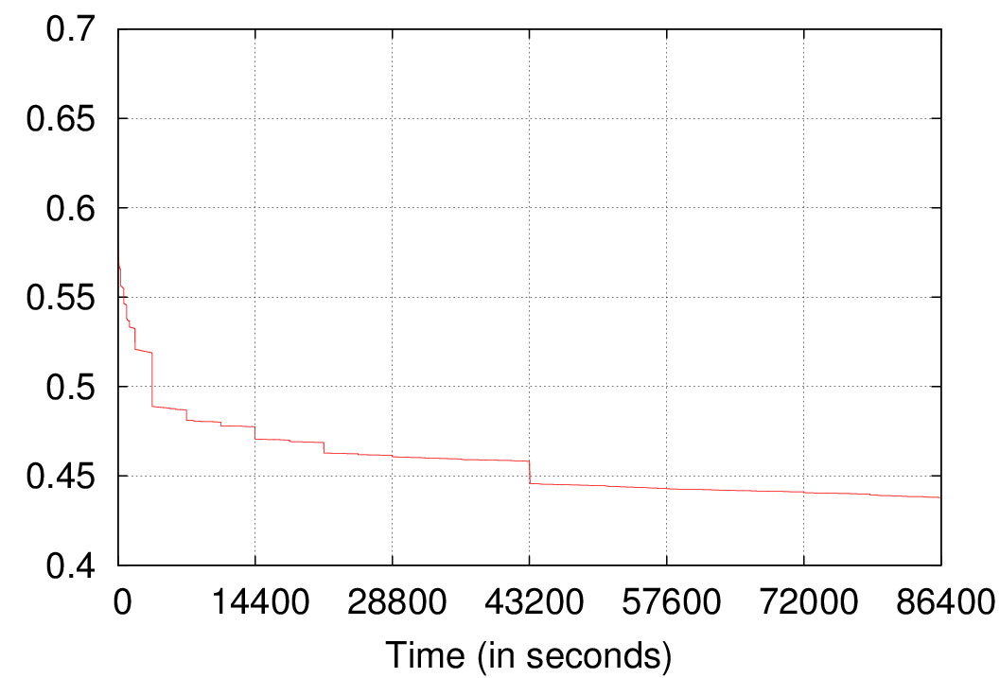
Overall Cache Lifetime Behavior
Responses left in cache over 24 hour period
Proportion of Responses remaining in cache

Slide 11
Simulation
Simulation will provide a more accurate savings estimate since it incorporates user patterns.
Each simulation run simulates typical user browsing session over 24 hours
Simulation ran for 2000 rounds
Savings per request = # of responses still cached / total # of responses for request
Average savings binned with intervals of 1 hour
Notes:
Savings binned, everything under 1 hour, 1 -> 2 hours, etc..

Slide 12
Setting up the Simulation
Spreadsheet of 4776 mobile webpages ordered into ascending order based on page ranking
Each row in spreadsheet represents one webpage
Each row contains the page rank and cache information (respSize, expAge)
Row number selected during simulation will be based on zipf distribution [4]
α = 0.85
Wait period between simulated user requests based on pareto distribution [5]
β = 1.5
k = 30
Notes:
In [4] authors suggest rank distribution of websites can be approximated by the zipf distribution.
Authors also suggest that this may be a universal property of the internet
In [5] authors evaluate effectiveness of strategies for reducing power consumption for mobile web access.
Construct model for single user’s traffic
User Think Times are distributed according to a Pareto distribution, when developing a single user’s traffic model.

Slide 13

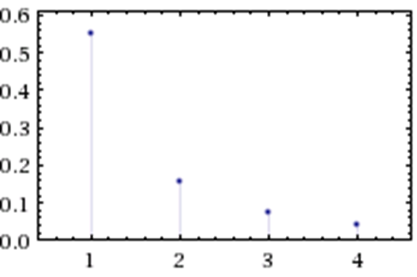
Zipf Distribution
α = 0.85
Graph courtesy of Wolfram Alpha
Notes:
Derives probability of page L
Used to determine what page is selected.

Slide 14

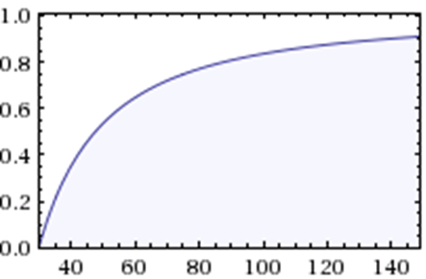
Pareto Distribution
β = 1.5, k = 30
Graph courtesy of Wolfram Alpha
Notes:
Cumulative probability distribution
Used to determine the wait time between user requests.

Slide 15
Simulation Algorithm
Performed 2000 times
While time < 86400 (1 day):
Row number = zipf(α = 0.85)
Find row in spreadsheet
For each cacheItem in row:
If expAge > time
Cache item isn’t expired
Accumulate savings
Time += ParetoValue(β = 1.5, k=30)

Slide 16
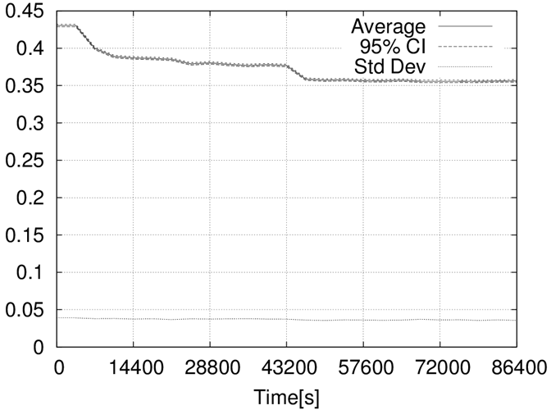
Simulation Results
Bytes remaining in cache over 24 hour period
Bytes remaining in cache
Notes:
4 hour increments in graph
Drops at 1 hours, 2 hours, 12 hours

Slide 17
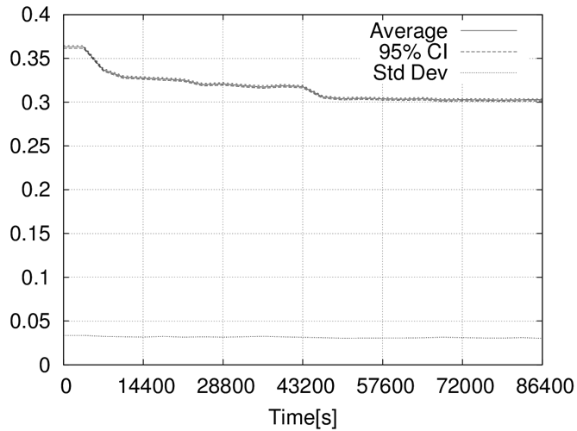
Simulation Results (cont.)
Responses remaining in cache over 24 hour period
Responses remaining in cache

Slide 18
Conclusion
Power savings can be achieved by pre-caching websites over night.
Data savings of up to 43% can be achieved, leveling off to 36% by the end of the day.
Response savings of up to 37% can be achieved, leveling off to 30% by the end of the day.

Slide 19
Future Works
Combine with user website visitation patterns to formulate a more accurate savings model.
Extend implementation past just the landing pages.
Also implement ways to account for website content changes that occur throughout day.

Slide 20
References
[1] Cisco, Inc., “Cisco visual networking index: Global mobile data traffic forecast update, 2013–2018,” Tech. Rep., Feb 2014.
[2] Thyamagondlu, B.N.; Chu, V.W.; Wong, R.K., "A Bandwidth-Conscious Caching Scheme for Mobile Devices," Big Data (BigData Congress), 2013 IEEE International Congress on , vol., no., pp.78,85, June 27 2013-July 2 2013 doi: 10.1109/BigData.Congress.2013.20

Slide 21
References (cont.)
[3] Huaping Shen, Mohan Kumar, Sajal K. Das, and Zhijun Wang. 2005. Energy-efficient data caching and prefetching for mobile devices based on utility. Mob. Netw. Appl. 10, 4 (August 2005), 475-486.
[4] S. A. Krashakov, A. B. Teslyuk, and L. N. Shchur, “On the universality of rank distributions of website popularity,” Computer Networks, vol. 50, no. 11, pp. 1769 – 1780, 2006. [Online]. Available: http://www.sciencedirect.com/science/article/pii/S1389128605002513
[5] G. Anastasi, M. Conti, E. Gregori, and A. Passarella, “Performance comparison of power-saving strategies for mobile web access,” Performance Evaluation, vol. 53, no. 3, pp. 273–294, 2003.

Slide 22

Questions

